Slide 1
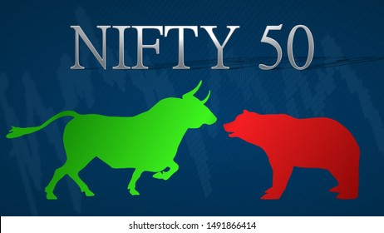
https://www.nseindia.com/
Dr. Narander Kumar Nigam

Slide 2
Introduction to Currency Markets
The current currency rate mechanism has evolved over thousands of years.
Initially, the trading of goods and services was by barter system where in goods were exchanged for each other.
Gradually metals became more prominent medium of exchange
Because of their ease of transportation, divisibility, certainty of quality and universal acceptance.
Amongst metals, gold and silver coins were most prominent and finally gold coins became the standard means of exchange

Slide 3
Introduction to Currency Markets
Due to international trade - evolution of foreign exchange (FX)
i.e., value of one currency of one country versus value of currency of other country.
The value of each currency against another currency was derived from gold exchange rate.
For example, if one unit of gold is valued at Indian Rupees (INR) 10,000 and US dollar (USD) 500 than the exchange rate of INR versus USD would be 1 USD = INR 20.

Slide 4
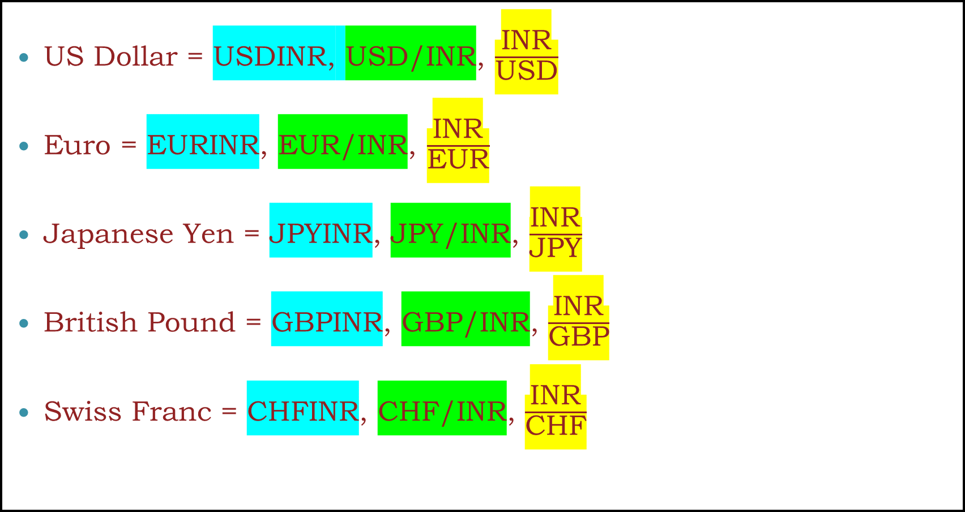
Currency pairs in India
US Dollar = USDINR, USD/INR, $\frac{\text{INR}}{\text{USD}}$
Euro = EURINR, EUR/INR, $\frac{\text{INR}}{\text{EUR}}$
Japanese Yen = JPYINR, JPY/INR, $\frac{\text{INR}}{\text{JPY}}$
British Pound = GBPINR, GBP/INR, $\frac{\text{INR}}{\text{GBP}}$
Swiss Franc = CHFINR, CHF/INR, $\frac{\text{INR}}{\text{CHF}}$

Slide 5
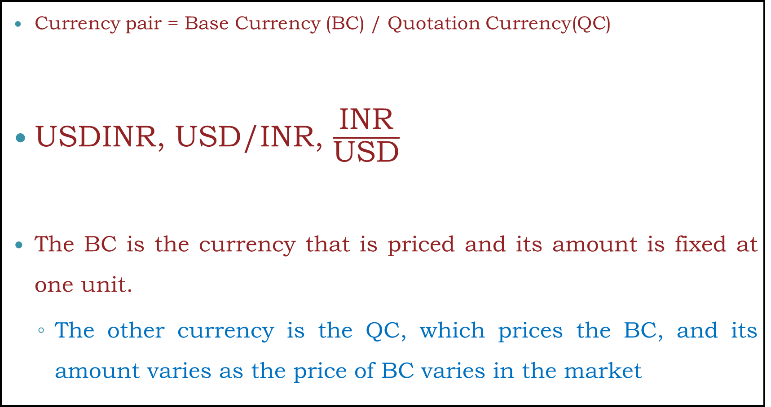
Currency pairs in India
Currency pair = Base Currency (BC) / Quotation Currency(QC)
USDINR, USD/INR, $\frac{\text{INR}}{\text{USD}}$
The BC is the currency that is priced and its amount is fixed at one unit.
The other currency is the QC, which prices the BC, and its amount varies as the price of BC varies in the market
QC
BC
BC
QC
QC
BC

Slide 6
Currency pairs - Trade
Buy USDINR is Buy BC and sell QC; Buy USD and sell INR
Sell USDINR is Sell BC and buy QC; sell USD and buy INR

Slide 7
Appreciation / Depreciation
USDINR has moved from 44.00 to 44.25, the USD has appreciated and the INR has depreciated.
USD looks strong over next few months would mean that USDINR pair may move towards 45.00 from the current levels of 44.00
USDINR has moved from 44.00 to 43.25, the USD has depreciated and the INR has appreciated.
USD looks week over next few months would mean that USDINR pair may move towards 44.00 from the current levels of 45.00

Slide 8
Exchange Derivatives
Derivative is a product whose value is derived from the value of one or more underlying asset.
The underlying asset can be equity, foreign exchange, commodity or any other asset.
A futures contract is a standardized contract, traded on an exchange, to buy or sell a certain underlying asset at a certain date in the future, at a specified price.
When the underlying is an exchange rate, the contract is termed a “currency futures contract”.

Slide 9
Futures Terminology
Spot price: The price at which the underlying asset trades in the spot market.
Futures price: The current price of the specified futures contract
Contract cycle: The period over which a contract trades. The currency futures contracts on the SEBI recognized exchanges have one-month, two-month, and three-month up to twelve-month expiry cycles. Hence, these exchanges will have 12 contracts outstanding at any given point in time.
Expiry date: Also called Last Trading Day, it is the day on which trading ceases in the contract; and is two working days prior to the final settlement date.

Slide 10
Futures Terminology
Contract size: The amount of asset that has to be delivered under one contract. Also called as lot size. In the case of USDINR it is USD 1000; EURINR it is EUR 1000; GBPINR it is GBP 1000 and in case of JPYINR it is JPY 100,000.
Initial margin: The amount that must be deposited in the margin account at the time a futures contract is first entered into is known as initial margin.
Marking-to-market: In the futures market, at the end of each trading day, the margin account is adjusted to reflect the investor's gain or loss depending upon the futures closing price. This is called marking-to-market

Slide 11
Interest rate parity and pricing of currency futures
Let us assume that risk free interest rate for one year deposit in India is 7% and in USA it is 3%.
You as smart trader/ investor will raise money from USA and deploy it in India and try to capture the arbitrage of 4%.
You could continue to do so and make this transaction as a non ending money making machine.
Life is not that simple! And such arbitrages do not exist for very long.

Slide 12
Interest rate parity and pricing of currency futures
Two important things to think before we proceed:
The loan taken in USA was in USD and you want INR. Therefore you need to convert INR into USD. So you will buy INR and sell USD; means USDINR sell in spot market because you want on the spot conversion.
Money invested in India will generate income (interest income) and at T1 you will sell INR and buy USD; means USDINR buy in future market because you want to transfer money to USA to pay loan payment.
In Short: - USDINR in SPOT + USDINR in future
This will push SPOT downward and futures upward.
And arbitrages do not exist for very long.

Slide 13
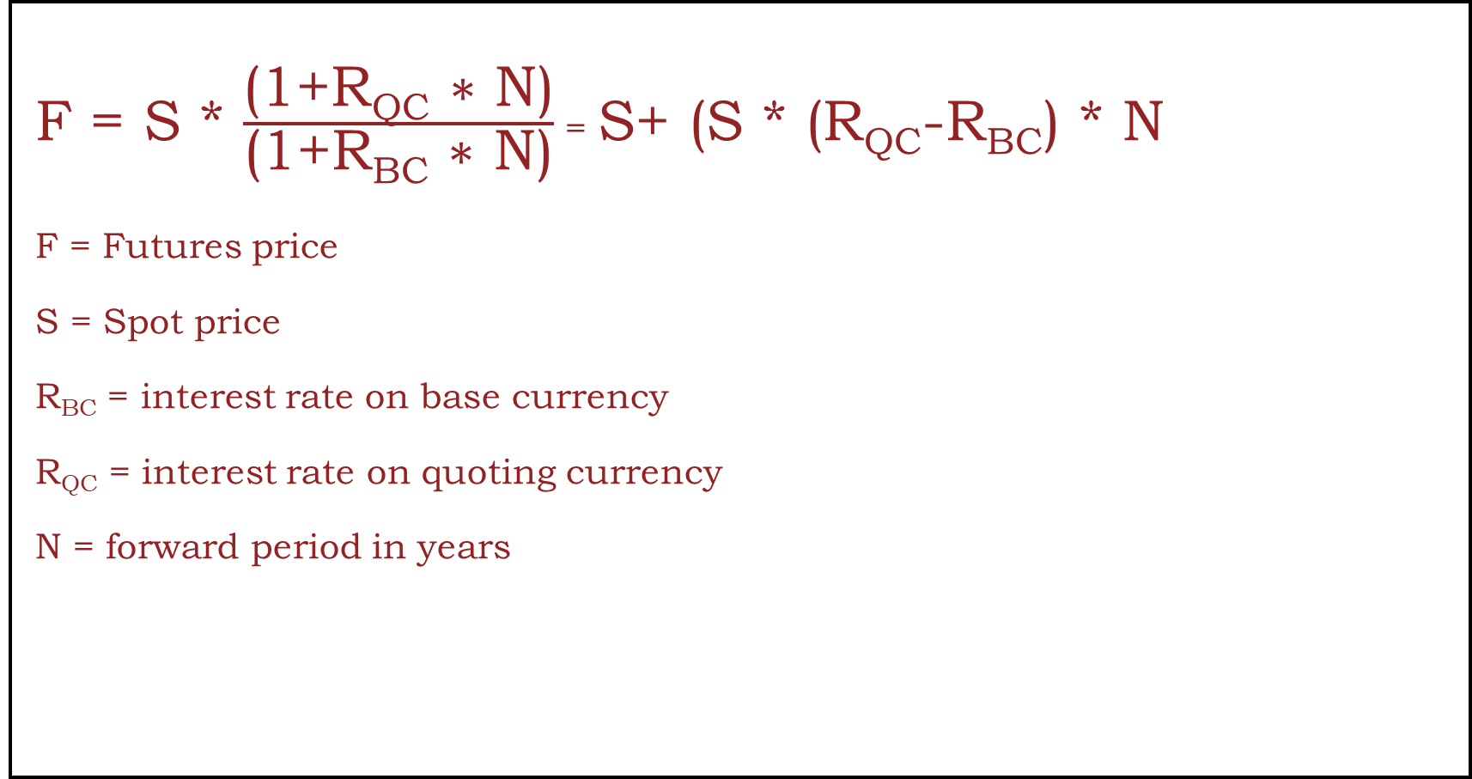
Valuation of currency futures
F = S * $\frac{\text{(1+}\text{RQC}\text{ ∗ }\text{N}\text{)}}{\text{(1+}\text{RBC}\text{ ∗ }\text{N}\text{)}}$ = S+ (S * (R_{QC}-R_{BC}) * N
F = Futures price
S = Spot price
R_{BC} = interest rate on base currency
R_{QC} = interest rate on quoting currency
N = forward period in years

Slide 14
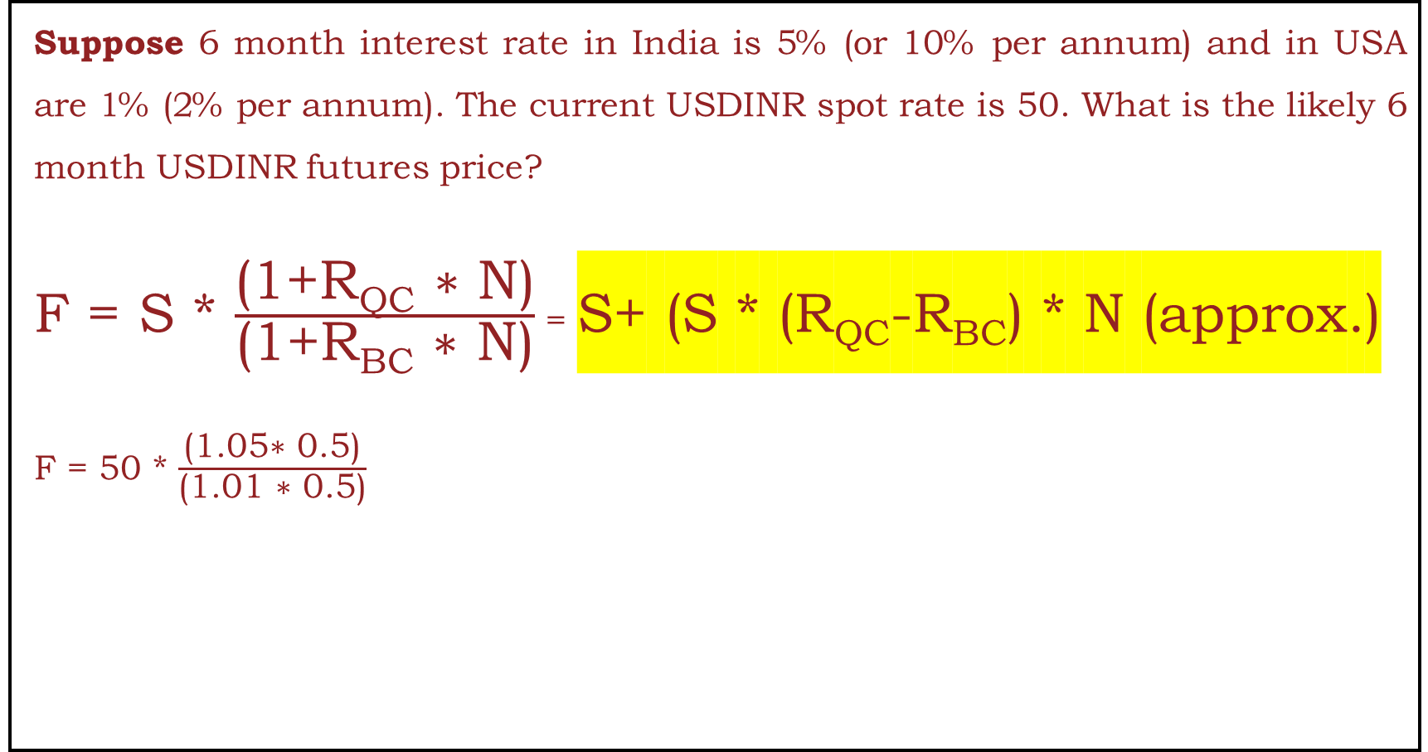
Valuation of currency futures
Suppose 6 month interest rate in India is 5% (or 10% per annum) and in USA are 1% (2% per annum). The current USDINR spot rate is 50. What is the likely 6 month USDINR futures price?
F = S * $\frac{\text{(1+}\text{RQC}\text{ ∗ }\text{N}\text{)}}{\text{(1+}\text{RBC}\text{ ∗ }\text{N}\text{)}}$ = S+ (S * (R_{QC}-R_{BC}) * N (approx.)
F = 50 * $\frac{\text{(}\text{1.05}\text{∗ }\text{0.5}\text{)}}{\text{(1}\text{.01}\text{ ∗ }\text{0.5}\text{)}}$

Slide 15
Concept of premium and discount
If one year future price of USDINR pair is 75 when spot price is 70.
It means that INR is at discount to USD and USD is at premium to INR.
Intuitively to understand why INR is called at discount to USD, think that to buy same 1 USD you had to pay INR 70 and you have to pay 75 after one year
i.e., you have to pay more INR to buy same 1 USD. And therefore future value of INR is at discount to USD.
Therefore in any currency pair, future value of a currency with high interest rate is at a discount (in relation to spot price) to the currency with low interest rate.

Slide 16
Hedging With Currency Forward
Early | Maturity | Post Maturity
Delivery | Delivery | Delivery
Cancelation | Cancelation | Cancelation
Extension | Extension | Extension

Slide 17
Hedging With Currency Forward
Early | Maturity | Post Maturity
Delivery | Delivery | Delivery
Cancelation | Cancelation | Cancelation
Extension | Extension | Extension

Slide 18
Early Delivery-Short Hedge
Q1. On 1st Jan 2022, Mr. Ram an exporter enters into a forward contract with SBI bank to sell 100,000 USD on 31st March 2022 @ 75.40. However, Mr. Ram received amount before date i.e., 26th Feb 2022. Hence, Mr. Ram requested bank to take delivery before due date i.e., 28th Feb 2022.
Inter Bank rate on 26th Feb 2022 was as follow:
Spot: 75.22 – 75.27
One-month premium 15/20 i.e., 75.37 – 75.47
Calculate net cash Inflow of Mr. Ram assuming Interest rate @ 12%.

Slide 19
Early Delivery-Short Hedge
Sol: Transection on 1st Jan 2022,
Costumer: Sell Forward @ 75.40
Bank: Buy Forward @ 75.40
Inter-bank market: Sell Forward @ 75.40+Profit

Slide 20
Early Delivery-Short Hedge
Sol: Transection on 1st Jan 2022,
Costumer: Sell Forward @ 75.40
Bank: Buy Forward @ 75.40
Inter-bank market: Sell Forward @ 75.40+Profit
Sol: Transection on 28th Feb 2022,
Costumer: Rec Payment @ 75.40
Bank: Sell Spot @ 75.22
Inter-bank market: Buy Forward @ 75.47

Slide 21
Early Delivery-Short Hedge
Sol: Transection on 1st Jan 2022,
Costumer: Sell Forward @ 75.40
Bank: Buy Forward @ 75.40
Inter-bank market: Sell Forward @ 75.40+Profit
Sol: Transection on 28th Feb 2022,
Costumer: Rec Payment @ 75.40
Bank: Sell Spot @ 75.22
Inter-bank market: Buy Forward @ 75.47
Net Amount Rec: 75.4*1,00,000 = 75,40,000
Less: Swap loss: (75.22-75.47) *1,00,000 = 25,000
Less Int Loss: 18000@12% for 1 Month = 180
Total: 75,14, 820

Slide 22
Early Delivery-Long Hedge
Q2. On 1st Jan 2022, Mr. Ram an Importer enters into a forward contract with SBI bank to buy 100,000 USD on 31st March 2022 @ 75.40. However, Mr. Ram have to pay before date i.e., 26th Feb 2022. Hence, Mr. Ram requested bank to take delivery before due date i.e., 28th Feb 2022.
Inter Bank rate on 26th Feb 2022 was as follow:
Spot: 75.22 – 75.27
One-month premium 15/20 i.e., 75.37 – 75.47
Calculate net cash outflow of Mr. Ram assuming Interest rate @ 12%.

Slide 23
Early Delivery-Long Hedge
Sol: Transection on 1st Jan 2022,
Costumer: Buy Forward @ 75.40
Bank: sell Forward @ 75.40
Inter-bank market: buy Forward @ 75.40+Profit

Slide 24
Early Delivery-Long Hedge
Sol: Transection on 1st Jan 2022,
Costumer: Buy Forward @ 75.40
Bank: sell Forward @ 75.40
Inter-bank market: buy Forward @ 75.40+Profit
Transection on 28th Feb 2022,
Costumer: Pay Payment @ 75.40
Bank: Buy Spot @ 75.27
Inter-bank market: sell Forward @ 75.37

Slide 25
Early Delivery-Long Hedge
Sol: Transection on 1st Jan 2022,
Costumer: Buy Forward @ 75.40
Bank: sell Forward @ 75.40
Inter-bank market: buy Forward @ 75.40+Profit
Transection on 28th Feb 2022,
Costumer: Pay Payment @ 75.40
Bank: Buy Spot @ 75.27
Inter-bank market: sell Forward @ 75.37
Net Amount Pay: 75.4*1,00,000 = 75,40,000
Less: Swap pft: (75.37-75.27) *1,00,000 = 10,000
Less Int gain: 13000@12% for 1 Month = 130
Total: 75,29, 870

Slide 26
Maturity Cancelation-Short Hedge
Q3. On 1st Jan 2022, Mr. Ram an exporter enters into a forward contract with SBI bank to sell 100,000 USD on 31st March 2022 @ 75.40. However, Mr. Ram did not receive the said amount on maturity date. Hence, Mr. Ram requested bank to cancel contract on maturity date.
Inter Bank rate on 31st March 2022 was as follow:
Spot: 75.22 – 75.27
One-month premium 15/20 i.e., 75.37 – 75.47
Additional Information
Interest rate @ 12%.
Bank charge 10p on each trade
Calculate net cash Inflow/Outflow of Mr. Ram

Slide 27
Maturity Cancelation-Short Hedge
Sol: Transection on 1st Jan 2022,
Costumer: Sell Forward @ 75.40
Bank: Buy Forward @ 75.40
Inter-bank market: Sell Forward @ 75.40+Profit

Slide 28
Maturity Cancelation-Short Hedge
Sol: Transection on 1st Jan 2022,
Costumer: Sell Forward @ 75.40
Bank: Buy Forward @ 75.40
Inter-bank market: Sell Forward @ 75.40+Profit
Transection on 31st March 2022.
Costumer: Buy spot @ 75.37
Bank: sell Spot @ 75.37
Inter-bank market: Deliver IBM

Slide 29
Maturity Cancelation-Short Hedge
Sol: Transection on 1st Jan 2022,
Costumer: Sell Forward @ 75.40
Bank: Buy Forward @ 75.40
Inter-bank market: Sell Forward @ 75.40+Profit
Transection on 31st March 2022.
Costumer: Buy spot @ 75.37
Bank: sell Spot @ 75.37
Inter-bank market: Deliver IBM
Sol:
Amount received in original contract 75,40,000
Amount pay for Spot Trade 75,37,000
Total 3,000

Slide 30
Maturity Cancelation-Long Hedge
Q4. On 1st Jan 2022, Mr. Ram an Importer enters into a forward contract with SBI bank to buy 100,000 USD on 31st March 2022 @ 75.40. However, Mr. Ram did not receive goods. Hence, requested bank to cancel contract on maturity date.
Inter Bank rate on 31st March 2022 was as follow:
Spot: 75.22 – 75.27
One-month premium 15/20 i.e., 75.37 – 75.47
Additional Information
Interest rate @ 12%.
Bank charge 0.5% on each trade
Calculate net cash Inflow/Outflow of Mr. Ram

Slide 31
Maturity Cancelation-Long Hedge
Sol: Transection on 1st Jan 2022,
Costumer: Buy Forward @ 75.40
Bank: Sell Forward @ 75.40
Inter-bank market: Buy Forward @ 75.40+Profit

Slide 32
Maturity Cancelation-Long Hedge
Sol: Transection on 1st Jan 2022,
Costumer: Buy Forward @ 75.40
Bank: Sell Forward @ 75.40
Inter-bank market: Buy Forward @ 75.40+Profit
Transection on 31st March 2022.
Costumer: Sell spot @ 75.22 – 75.22*0.005 = 75.22-0.3761= 74.8439
Bank: Buy Spot @ 74.8439
Inter-bank market: Take Delivery IBM

Slide 33
Maturity Cancelation-Long Hedge
Sol: Transection on 1st Jan 2022,
Costumer: Buy Forward @ 75.40
Bank: Sell Forward @ 75.40
Inter-bank market: Buy Forward @ 75.40+Profit
Transection on 31st March 2022.
Costumer: Sell spot @ 75.22 – 75.22*0.005 = 75.22-0.3761= 74.8439
Bank: Buy Spot @ 74.8439
Inter-bank market: Take Delivery IBM
Sol:
Amount Pay in original contract 75,40,000
Amount rec for Spot Trade 74,84,390
Total loss (55,610)

Slide 34
Early Cancelation-Short Hedge
Q5. On 1st Jan 2022, Mr. Ram an exporter enters into a forward contract with SBI bank to sell 100,000 USD on 31st March 2022 @ 75.40. Further, Mr. Ram received information about cancelation of original deal from counter party on date i.e., 26th Feb 2022. Therefore, Mr. Ram requested bank to cancel forward before due date i.e., 28th Feb 2022.
Inter Bank rate on 26th Feb 2022 was as follow:
Spot: 75.22 – 75.27
One-month premium 15/20 i.e., 75.37 – 75.47
Additional Information
Interest rate @ 12%.
Bank charge 10p on each trade
Calculate net cash Inflow/Outflow of Mr. Ram

Slide 35
Early Cancelation-Short Hedge
Sol: Transection on 1st Jan 2022,
Costumer: Sell Forward @ 75.40
Bank: Buy Forward @ 75.40
Inter-bank market: Sell Forward @ 75.40+Profit

Slide 36
Early Cancelation-Short Hedge
Sol: Transection on 1st Jan 2022,
Costumer: Sell Forward @ 75.40
Bank: Buy Forward @ 75.40
Inter-bank market: Sell Forward @ 75.40+Profit
Sol: Transection on 28th Feb 2022,
Costumer: Buy 1 month Forward @ 75.57
Bank: Sell 1 month Forward @ 75.57
Inter-bank market: Buy 1 month Forward @ 75.47

Slide 37
Early Cancelation-Short Hedge
Sol: Transection on 1st Jan 2022,
Costumer: Sell Forward @ 75.40
Bank: Buy Forward @ 75.40
Inter-bank market: Sell Forward @ 75.40+Profit
Sol: Transection on 28th Feb 2022,
Costumer: Buy 1 month Forward @ 75.57
Bank: Sell 1 month Forward @ 75.57
Inter-bank market: Buy 1 month Forward @ 75.47
Net Amount Rec: 75.40 - 75.57*1,00,000 = (17,000)

Slide 38
Early Cancelation-Long Hedge
Q6. On 1st Jan 2022, Mr. Ram an Importer enters into a forward contract with SBI bank to buy 100,000 USD on 31st March 2022 @ 75.40. Further, Mr. Ram received information about cancelation of original deal from counter party on date i.e., 26th Feb 2022. Therefore, Mr. Ram requested bank to cancel forward before due date i.e., 28th Feb 2022.
Inter Bank rate on 26th Feb 2022 was as follow:
Spot: 75.22 – 75.27
One-month premium 15/20 i.e., 75.37 – 75.47
Additional Information
Interest rate @ 12%.
Bank charge 10p on each trade
Calculate net cash Inflow/Outflow of Mr. Ram

Slide 39
Early Cancelation-Long Hedge
Sol: Transection on 1st Jan 2022,
Costumer: Buy Forward @ 75.40
Bank: Sell Forward @ 75.40
Inter-bank market: Buy Forward @ 75.40+Profit

Slide 40
Early Cancelation-Long Hedge
Sol: Transection on 1st Jan 2022,
Costumer: Buy Forward @ 75.40
Bank: Sell Forward @ 75.40
Inter-bank market: Buy Forward @ 75.40+Profit
Sol: Transection on 28th Feb 2022,
Costumer: Sell 1 month Forward @ 75.27
Bank: Buy 1 month Forward @ 75.27
Inter-bank market: Sell Forward @ 75.37

Slide 41
Early Cancelation-Long Hedge
Sol: Transection on 1st Jan 2022,
Costumer: Buy Forward @ 75.40
Bank: Sell Forward @ 75.40
Inter-bank market: Buy Forward @ 75.40+Profit
Sol: Transection on 28th Feb 2022,
Costumer: Sell 1 month Forward @ 75.27
Bank: Buy 1 month Forward @ 75.27
Inter-bank market: Sell Forward @ 75.37
Net Amount Pay: 75.27 - 75.40*1,00,000 = (13,000)

Slide 42
Maturity Extension -Short Hedge
Q7. On 1st Jan 2022, Mr. Ram an exporter enters into a forward contract with SBI bank to sell 100,000 USD on 31st March 2022 @ 75.40. However, counterparty of Mr. Ram informed a delay of 1 Month on maturity date. Hence, Mr. Ram requested bank 1 month extension on maturity date.
Inter Bank rate on 31st March 2022 was as follow:
Spot: 75.22 – 75.27
One-month premium 15/20 i.e., 75.37 – 75.47
Additional Information
Interest rate @ 12%.
Bank charge 10p on each trade
Calculate net cash Inflow/Outflow of Mr. Ram

Slide 43
Maturity Extension -Short Hedge
Sol: Transection on 1st Jan 2022,
Costumer: Sell Forward @ 75.40
Bank: Buy Forward @ 75.40
Inter-bank market: Sell Forward @ 75.40+Profit

Slide 44
Maturity Extension -Short Hedge
Sol: Transection on 1st Jan 2022,
Costumer: Sell Forward @ 75.40
Bank: Buy Forward @ 75.40
Inter-bank market: Sell Forward @ 75.40+Profit
Transection on 31st March 2022.
Costumer: Buy spot @ 75.37
Bank: sell Spot @ 75.37
Inter-bank market: Deliver IBM
Costumer: Sell 1 month Forward @ 75.27
Bank: Buy 1 month Forward @ 75.27
Inter-bank market: Sell 1 month Forward @ 75.37

Slide 45
Maturity Extension -Short Hedge
Sol: Transection on 1st Jan 2022,
Costumer: Sell Forward @ 75.40
Bank: Buy Forward @ 75.40
Inter-bank market: Sell Forward @ 75.40+Profit
Transection on 31st March 2022.
Costumer: Buy spot @ 75.37
Bank: sell Spot @ 75.37
Inter-bank market: Deliver IBM
Costumer: Sell 1 month Forward @ 75.27
Bank: Buy 1 month Forward @ 75.27
Inter-bank market: Sell 1 month Forward @ 75.37
Swap Loss (75.37 – 75.27) *1,00,000 = (10,000)
Interest gains (75.40-75.37) *1,00,000 = 3000 * 0.12 * 1/12 = 30
Total (9,970)

Slide 46
Maturity Extension -Long Hedge
Q8. On 1st Jan 2022, Mr. Ram an Importer enters into a forward contract with SBI bank to buy 100,000 USD on 31st March 2022 @ 75.40. However, counterparty of Mr. Ram informed a delay of 1 Month on maturity date. Hence, Mr. Ram requested bank 1 month extension on maturity date.
Inter Bank rate on 31st March 2022 was as follow:
Spot: 75.22 – 75.27
One-month premium 15/20 i.e., 75.37 – 75.47
Additional Information
Interest rate @ 12%.
Bank charge 0.5% on each trade
Calculate net cash Inflow/Outflow of Mr. Ram

Slide 47
Maturity Extension -Long Hedge
Sol: Transection on 1st Jan 2022,
Costumer: Buy Forward @ 75.40
Bank: Sell Forward @ 75.40
Inter-bank market: Buy Forward @ 75.40+Profit

Slide 48
Maturity Extension -Long Hedge
Sol: Transection on 1st Jan 2022,
Costumer: Buy Forward @ 75.40
Bank: Sell Forward @ 75.40
Inter-bank market: Buy Forward @ 75.40+Profit
Transection on 31st March 2022.
Costumer: Sell spot @ 75.22 – 75.22*0.005 = 75.22-0.3761= 74.8439
Bank: Buy Spot @ 74.8439
Inter-bank market: Take Delivery IBM
Costumer: Buy 1 month Forward @ 75.84735 (75.47+0.005*75.47)
Bank: sell 1 month Forward @ 75.84735
Inter-bank market: Buy 1 month Forward @ 75.47

Slide 49
Maturity Extension -Long Hedge
Sol: Transection on 1st Jan 2022,
Costumer: Buy Forward @ 75.40
Bank: Sell Forward @ 75.40
Inter-bank market: Buy Forward @ 75.40+Profit
Transection on 31st March 2022.
Costumer: Sell spot @ 75.22 – 75.22*0.005 = 75.22-0.3761= 74.8439
Bank: Buy Spot @ 74.8439
Inter-bank market: Take Delivery IBM
Costumer: Buy 1 month Forward @ 75.84735 (75.47+0.005*75.47)
Bank: sell 1 month Forward @ 75.84735
Inter-bank market: Buy 1 month Forward @ 75.47
Swap Loss (74.8439 – 75.84735) *1,00,000 = (1,00,345)
Interest Charges (74.8439-75.40) *1,00,000 = 55,610 * 0.12 * 1/12 = 556.1
Total (1,00,901.1)

Slide 50
Early Extension -Short Hedge
Q9. On 1st Jan 2022, Mr. Ram an exporter enters into a forward contract with SBI bank to sell 100,000 USD on 31st March 2022 @ 75.40. However, counterparty of Mr. Ram informed a delay of 2 Month on date i.e., 26th Feb 2022. Hence, Mr. Ram requested bank 2-month extension on from 28th Feb 2022.
Inter Bank rate on 26th Feb 2022 was as follow:
Spot: 75.22 – 75.27
One-month premium 15/20 i.e., 75.37 – 75.47
Two-month premium 35/40 i.e., 75.57 – 75.67
Additional Information
Interest rate @ 12%.
Bank charge 10p on each trade
Calculate net cash Inflow/Outflow of Mr. Ram

Slide 51
Early Extension -Short Hedge
Sol: Transection on 1st Jan 2022,
Costumer: Sell Forward @ 75.40
Bank: Buy Forward @ 75.40
Inter-bank market: Sell Forward @ 75.40+Profit

Slide 52
Early Extension -Short Hedge
Sol: Transection on 1st Jan 2022,
Costumer: Sell Forward @ 75.40
Bank: Buy Forward @ 75.40
Inter-bank market: Sell Forward @ 75.40+Profit
Transection on 28th Feb 2022,
Costumer: Buy 1 month Forward @ 75.57
Bank: Sell 1 month Forward @ 75.57
Inter-bank market: Buy 1 month Forward @ 75.47
__________________________________________________
Costumer: Sell 2 month Forward @ 75.47
Bank: Buy 2 month Forward @ 75.47
Inter-bank market: Sell 2 month Forward @ 75.57

Slide 53
Early Extension -Short Hedge
Sol: Transection on 1st Jan 2022,
Costumer: Sell Forward @ 75.40
Bank: Buy Forward @ 75.40
Inter-bank market: Sell Forward @ 75.40+Profit
Transection on 28th Feb 2022,
Costumer: Buy 1 month Forward @ 75.57
Bank: Sell 1 month Forward @ 75.57
Inter-bank market: Buy 1 month Forward @ 75.47
__________________________________________________
Costumer: Sell 2 month Forward @ 75.47
Bank: Buy 2 month Forward @ 75.47
Inter-bank market: Sell 2 month Forward @ 75.57
Swap Loss (75.57 – 75.47) *1,00,000 = (10,000)
Interest Charges (75.40-75.57) *1,00,000 = 17,000 * 0.12 * 1/12 = (170)
Total (10,170)

Slide 54
Early Extension -Long Hedge
Q10. On 1st Jan 2022, Mr. Ram an Importer enters into a forward contract with SBI bank to buy 100,000 USD on 31st March 2022 @ 75.40. However, counterparty of Mr. Ram informed a delay of 2 Month on date i.e., 26th Feb 2022. Hence, Mr. Ram requested bank 2-month extension on from 28th Feb 2022.
Inter Bank rate on 26th Feb 2022 was as follow:
Spot: 75.22 – 75.27
One-month premium 15/20 i.e., 75.37 – 75.47
Two-month premium 35/40 i.e., 75.57 – 75.67
Additional Information
Interest rate @ 12%.
Bank charge 10p on each trade
Calculate net cash Inflow/Outflow of Mr. Ram

Slide 55
Early Extension -Long Hedge
Sol: Transection on 1st Jan 2022,
Costumer: Buy Forward @ 75.40
Bank: Sell Forward @ 75.40
Inter-bank market: Buy Forward @ 75.40+Profit

Slide 56
Early Extension -Long Hedge
Sol: Transection on 1st Jan 2022,
Costumer: Buy Forward @ 75.40
Bank: Sell Forward @ 75.40
Inter-bank market: Buy Forward @ 75.40+Profit
Transection on 28th Feb 2022,
Costumer: Sell 1 month Forward @ 75.27
Bank: Buy 1 month Forward @ 75.27
Inter-bank market: Sell Forward @ 75.37
Costumer: Buy 2 month Forward @ 75.77
Bank: Sell 2 month Forward @ 75.77
Inter-bank market: Buy 2 month Forward @ 75.67

Slide 57
Early Extension -Long Hedge
Sol: Transection on 1st Jan 2022,
Costumer: Buy Forward @ 75.40
Bank: Sell Forward @ 75.40
Inter-bank market: Buy Forward @ 75.40+Profit
Transection on 28th Feb 2022,
Costumer: Sell 1 month Forward @ 75.27
Bank: Buy 1 month Forward @ 75.27
Inter-bank market: Sell Forward @ 75.37
Costumer: Buy 2 month Forward @ 75.77
Bank: Sell 2 month Forward @ 75.77
Inter-bank market: Buy 2 month Forward @ 75.67
Swap Loss (75.27 – 75.77) *1,00,000 = (50,000)
Interest Charges (75.27-75.40) *1,00,000 = 13,000 * 0.12 * 1/12 = (130)
Total (50,130)

Slide 58
Thank you

